Slide 2
Security Issues in Internet Protocols – Part 3
Dr. Sandra Scott-Hayward
CSC3064 Lecture 08
School of Electronics, Electrical Engineering and Computer Science

Slide 3
Session Overview
Security of DNS
References:
Schäfer, Günter, and Michael Rossberg. Security in Fixed and Wireless Networks. John Wiley & Sons, 2016.
Stallings, William. Network security essentials: applications and standards. Pearson Education India, 2007.

Slide 4
Internet Infrastructure
Backbone
ISP
ISP
Local and inter-domain routing
TCP/IP for routing and messaging
ARP for address resolution
OSPF for inter-AS routing
BGP for routing announcements
Domain Name System
Find IP address from symbolic name (www.qub.ac.uk)
https://www.zdnet.com/article/internet-experiment-goes-wrong-takes-down-a-bunch-of-linux-routers/

Slide 5
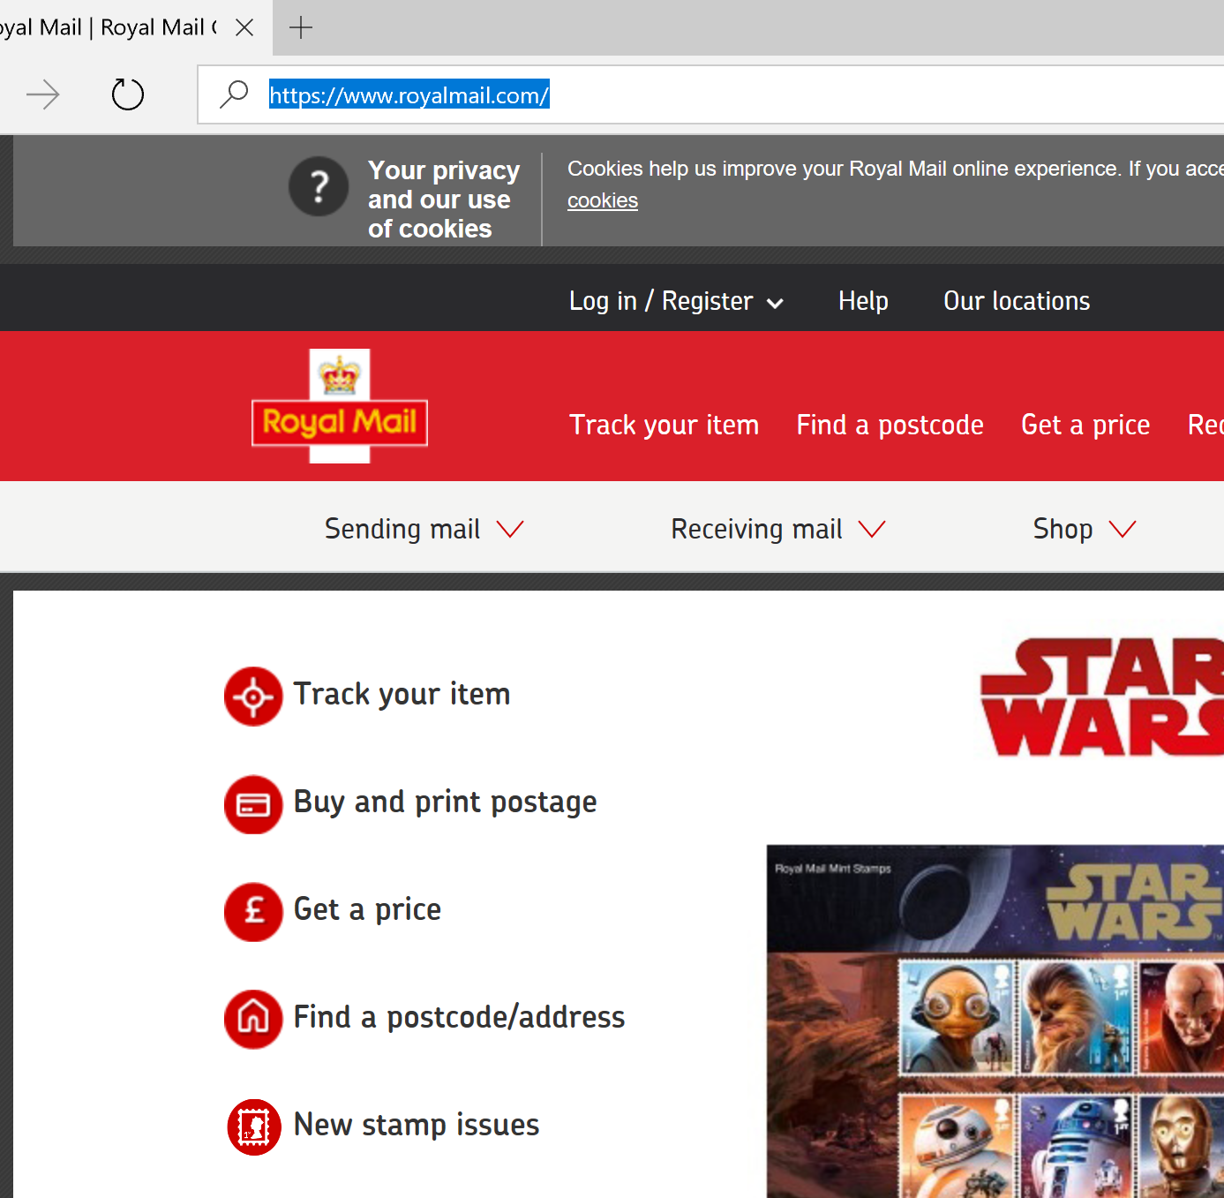
DNS – The Domain Name System
Naming service for Internet traffic
Lookup of (resolve)
IP addresses
Mail servers
Alias names
Alternative name servers
…
Decentralized database consisting of a multitude of servers

Slide 6
DNS – Hierarchical Name Space
root
Top Domain
org
net
uk
com
edu
de
Second-level Domain
nhs
ac
gov
co
Second-level Domain
bristol
ox
qub
ucl
gla
Subdomain
csit
ecit
www

Slide 7
DNS – Data Organisation: Domains/Zones
Structured Namespace
Hierarchical organization in sub domains/zones
Sourced at “root zone” (“.”)
Parent zones maintain pointers to child zones (“zone cuts”)
Zone data is stored as “Resource Records” (RR)
.
Root Domain Server
Internic
Server
DENIC Server
com
org
de
google
apple
zeit
bund
Federal Office of Administration
www
maps
bmbf
bsi
Google Server
www

Slide 8
DNS Components
Authoritative Server
Server maintaining authoritative content of a complete DNS zone
Top-Level-Domain (TLD) servers & auth servers of organization’s domains
Pointed to in parent zone as authoritative
Possible load balancing: master/slaves
Recursive (Caching) Server
Local proxy for DNS requests
Caches content for specified period of time (soft-state with TTL)
If data not available in the cache, request is processed recursively
Resolver
Software on client’s machines (part of the OS)
Windows, MacOS, and *nix: Stub resolvers
Delegate request to local server

Slide 9
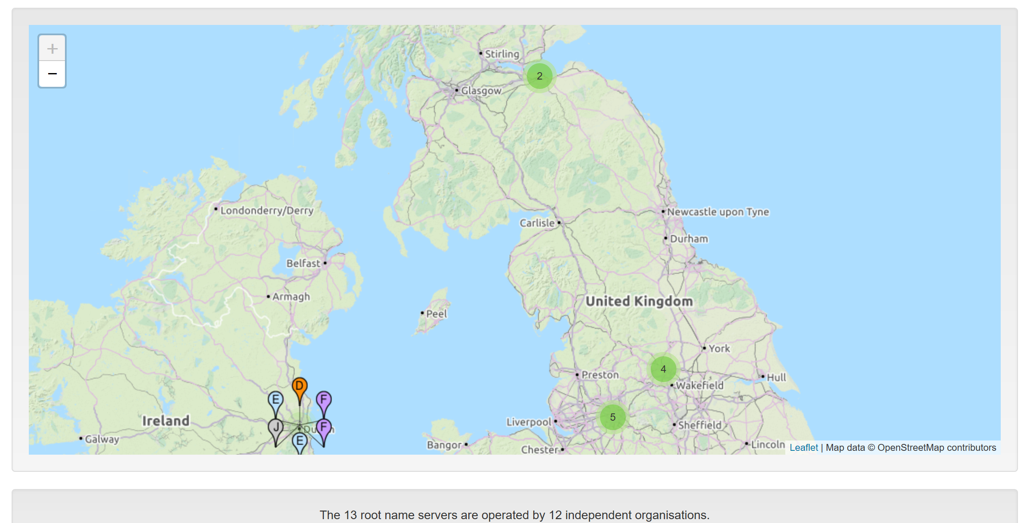
DNS Root Name Servers
Hierarchical service
Root name servers for top-level domains
Authoritative name servers for subdomains
Local name resolvers contact authoritative servers when they do not know a name
http://root-servers.org/

Slide 10
DNS Lookup Example
root & edu
DNS server
www.cs.stanford.edu
www.cs.stanford.edu
NS stanford.edu
stanford.edu
DNS server
Local DNS resolver
NS cs.stanford.edu
Client
A www=IPaddr
cs.stanford.edu
DNS server
DNS record types (partial list):
- NS: name server (points to other server)
- A: address record (contains IP address)

Slide 11
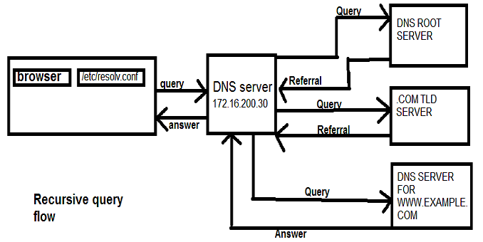
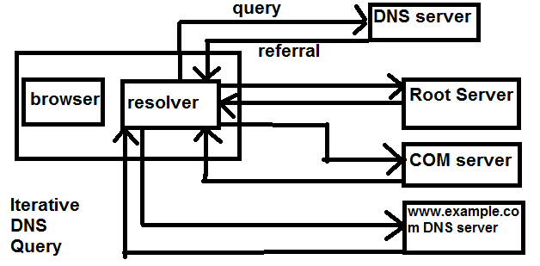
Recursive vs. Iterative Query

Slide 12
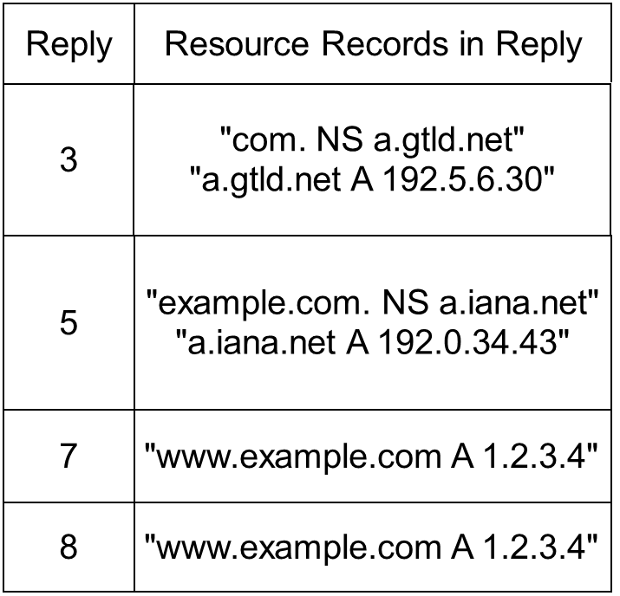
Recursive and iterative queries
Query: "www.example.com A?"
root DNS server
iterative
Auth DNS server
(TLD: a.iana.net)
2
3
local (caching) DNS server
4
5
iterative
Auth DNS server
(TUI: example.com)
recursive
6
1
7
iterative
8
example.com
Local recursive resolver caches these for TTL specified by RR

Slide 13
DNS Resource Records
Atomic entries in DNS are called “Resource Records” (RR)
Format:
<name> [<ttl>] [<class>] <type> <rdata>
name (domain name of resource)
ttl (Time-to-live)
class (used protocol): IN (Internet),
type (record type): A (Host-Address), NS (Name Server),
MX (Mail Exchange), CNAME (Canonical Name),
AAAA (IPv6-Host-Address), DNAME (CNAME, IPv6)
rdata (resource data): Content! (What did we want to look up?)

Slide 14
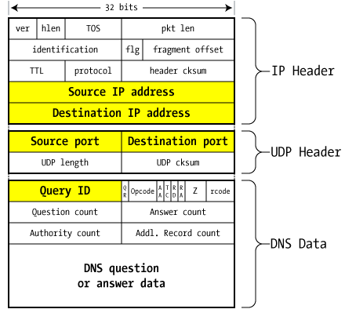
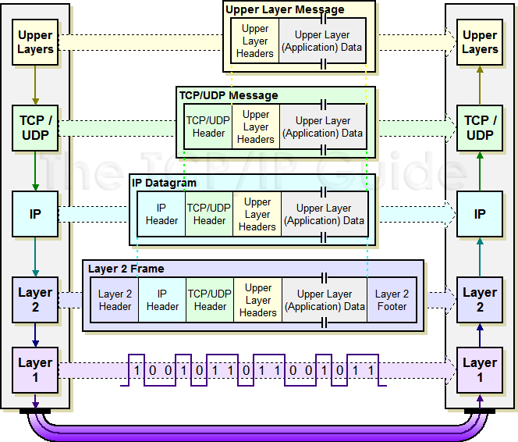
DNS Packet
Query ID:
16 bit random value
Links response to query
Remember encapsulation:

Slide 15
DNS Message Format
Q/R Query/Response Flag
Operation Code
AA Auth. Answer Flag
TC Truncation Flag
0
1
2
3
Identification
Flags and Codes
Question Count
Answer Record Count
Name Server (Auth Record) Count
Additional Record Count
RD Recursion Desired Flag
RA Recursion Available Flag
Zero (three resv. bits)
Response Code
Questions
Answers
Authority
Additional Information
Q/R OPCode AA TC RD RA Zero RespCode
16 17 21 22 23 24 25 28 31

Slide 16
DNS Header Fields
Identifier: a 16-bit identification field generated by the device that creates the DNS query. It is copied by the server into the response, so it can be used by that device to match that query to the corresponding reply
Query/Response Flag: differentiates between queries and responses (0 ~ Query, 1 ~ Response)
Operation Code: specifies the type of message (Query, Status, Notify, Update)
Authoritative Answer Flag (AA): set to1 if the answer is authoritative
Truncation Flag: When set to 1, indicates that the message was truncated due to its length (might happen with UDP, requestor can then decide to ask again with TCP as transport service)
Recursion Desired: set to 1 if requester desired recursive processing
Recursion Available: set to 1 if server supports recursive queries

Slide 17
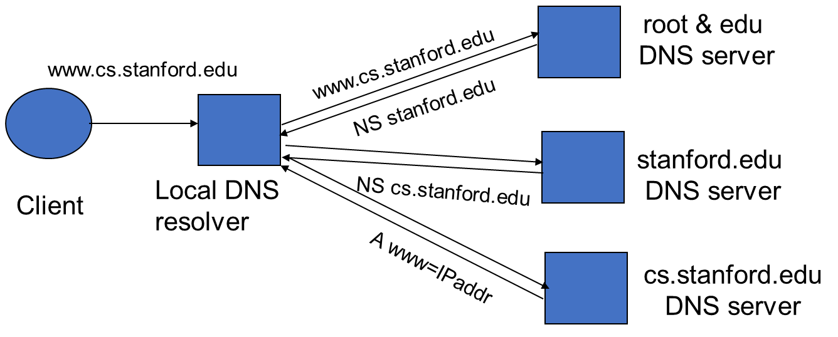
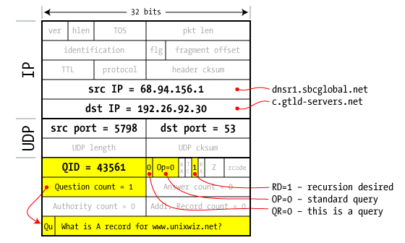
Resolver to NS Request

Slide 18
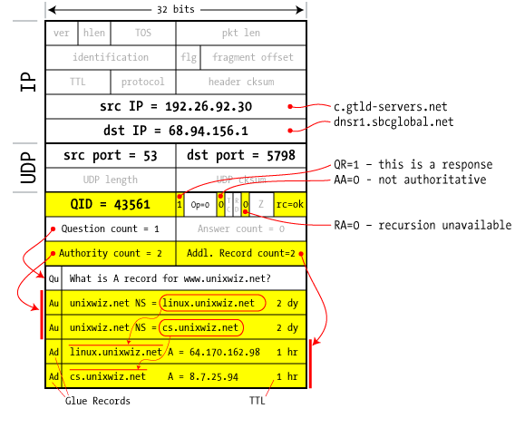
Response to resolver
Response contains IP address of next NS server (called “glue”)
Response ignored if unrecognized QueryID

Slide 19
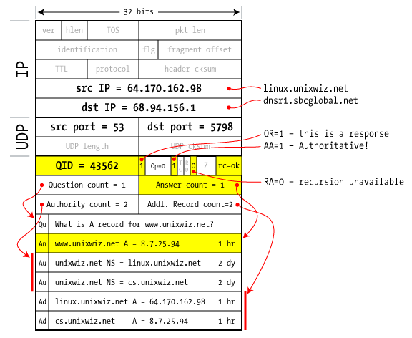
Authoritative response to resolver
final answer

Slide 20
DNS – Data Flow
Root Server
TLD Server
Zone
File
Zone
File
Static Mapping
Caching
Server
Authoritative Server
Zone
File
Dynamic Mapping
by DHCP etc.
Resolver
Backup Server
Overview of DNS at: https://www.cloudflare.com/learning/dns/what-is-dns/

Slide 21
Basic DNS vulnerabilities
Users/hosts trust the host-address mapping provided by DNS:
Used as basis for many security policies:
Browser same origin policy, URL address bar
Obvious problems
Interception of requests or compromise of DNS servers can result in incorrect or malicious responses
E.g. A malicious access point in a Cafe
Solution – authenticated requests/responses
Provided by DNSSEC … but few use DNSSEC

Slide 22
Security of the Domain Name System (DNS)
Vital service for the Internet
“Do you know the IP-Address of your mail server?”
“You know you should not follow the link
http://very.malicio.us
but what about
http://www.yourbank.de ??”
But: DNS does not support
Data integrity
Data origin authentication
Threats:
Data Authenticity/Integrity
Denial of Service

Slide 23
DNS Security Objectives
Authentication and integrity of name mappings
Most prominent thread: Cache Poisoning
Simple Countermeasures:
Random Port Numbers, Split-Horizon DNS, …
Cryptographic countermeasures
Data Integrity with TSIG records
DNSSEC
Availability
DNS being a target of DoS attacks
DNS being a means of amplification attacks
(Confidentiality & Access Control)

Slide 24
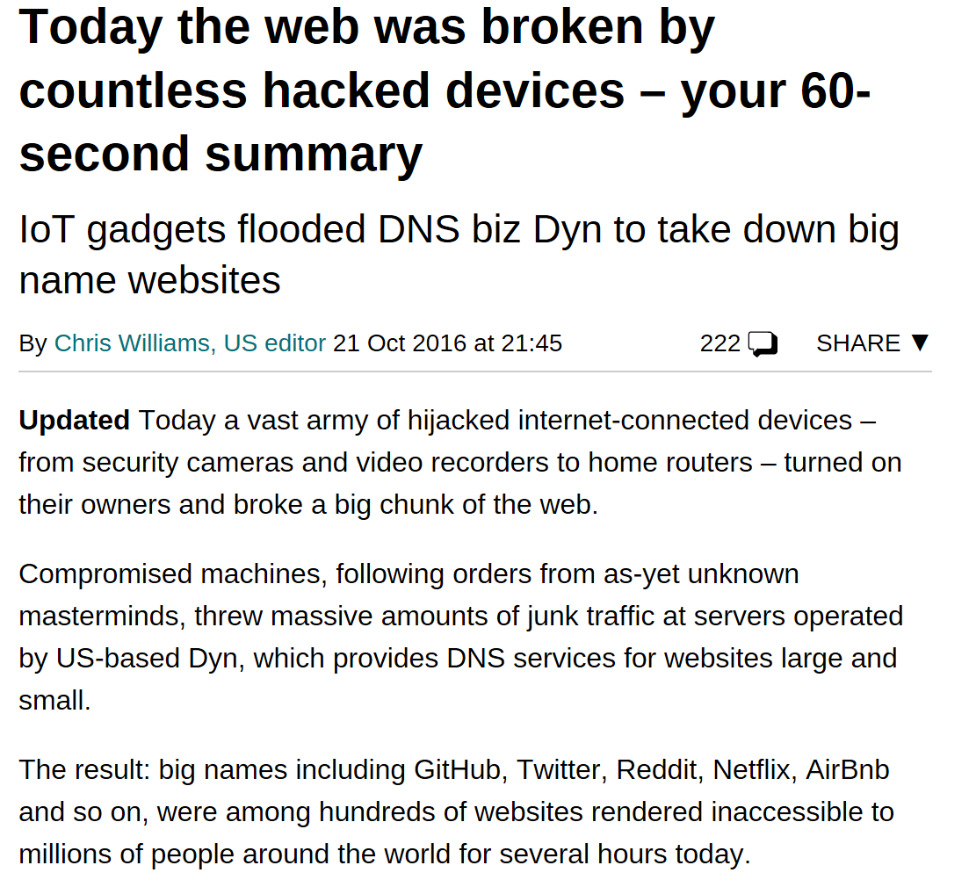
Threats to DNS: Denial of Service
DNS itself as a vital service is a “worthy” target
Without DNS most Internet services will not work (usage of names rather than IP-Addresses for numerous reasons!)
DDoS attacks on root servers
DNS amplification attacks
Spoofed queries (60 Bytes) may generate potentially large responses (4KBytes) Type: “ANY”
Exploit open recursive servers to generate load on other DNS servers
Exploit open servers as reflectors when flooding a victim with traffic (via source IP Address spoofing in request)

Slide 25
DNS: Robustness to DDoS
Secure DNS server
OS selection and updates
Firewalls
Server software selection and updates
Redundancy and over provisioning
Root “.”: 13 name server “names” ({a..m}.root-servers.net)
“com”, “net” 13 name servers each
“de” 16 name servers
Anycast
Announcement of an IP prefix from multiple locations
Requests from different parts of the internet are routed to different machines with the same IP address
Done by 11 of the 13 root-servers (2 others underway)

Slide 26
Threats to DNS: Data Integrity and Authentication
Illegitimate
change
of owner
TLD Server
Zone
File
Cache
Poisoning
Static Mapping
Caching
Server
Authoritative Server
Cache
Impersonation
Zone
File
Impersonating
Master
Mapping
Compromise
Dynamic Mapping
by DHCP etc.
Resolver
Unauthorized
Refreshes
Backup Server
Modification of
database

Slide 27
DNS: Caching
DNS responses are cached
Quick response for repeated translations
Note: NS records for domains also cached
DNS negative queries are cached
Save time for non-existent sites, e.g. misspelling
Cached data periodically times out
Lifetime (TTL) of data controlled by owner of data
TTL passed with every record

Slide 28
Threats to DNS: Data Corruption/Cache Poisoning
All resolved RRs are cached at local DNS servers
DNS slave servers replicate zone data from master
Normal DNS lookup:
port_x: static in old DNS servers
Q-ID_x: chosen sequentially in old
DNS servers
S: <port_X>
D: 53/udp
Q-ID_x
Auth DNS server
2
S: <port_v>
D: 53/udp
Q-ID_v
1
3
S: 53
D: <port_v>
Q-ID_v
Victim
4
local DNS server (X)

Slide 29
Threats to DNS: Cache Poisoning
Simple Poisoning (1)
The Attack: Put fake data in slaves / caching servers
(and nobody will realize the redirection from www.yourbank.de to very.malicio.us …)
Enabling features of the attack:
DNS via UDP => no handshakes for connection establishment
Transactions in DNS only through tuple of
<auth server(ip address), auth server(port), transaction id>
IP Address of authoritative name servers are well known
In many implementations same port for all transactions
Q-ID unknown, but: servers used to choose them sequentially…

Slide 30
Threats to DNS: Cache Poisoning
Simple Poisoning (2)
Attacker sends request for target domain
Cache server performs lookup
Attacker sends fake information to known port_x, with last Q-ID +1 and source address of correct Auth DNS server
Second reply (by correct Auth DNS server) is ignored
Authoritative Server
Attacker requests DNS info on own domain
Victim‘s cache requests info recursively
Port and last Q-ID known to Attacker
5.
8.
2.
9.
Authoritative
Server
of attacker
Caching
Server
1.
Victim
4.
3.
6.
Victim requests IP for host in target domain
Local DNS server answers with poisoned info
7.
Off-path
Attacker

Slide 31
Mitigation of DNS Cache Poisoning
Random ports for each transaction (BIND8)
Since Version 8 BIND uses PRNG for port number and query id selection
However PRNG == Pseudo Random Number Generator, with knowledge about previous port numbers future port numbers can be guessed if PRNG not cryptographically secure
More random ports for each transaction (BIND9)
New and better PRNG since BIND9, random numbers are harder to guess
Cache Poisoning usually only after aging of entry in local DNS server
Only if attacker attacks at the right moment, it can poison the cache
Typical TTL:
172800 (2d) for most name servers
Seconds to hours for A-Entries of organizations (tu-ilmenau.de 4h, deutschebank.de 30min, commerzbank.de 60mins, postbank.de 60s)
Nevertheless: cache poisoning is still not completely solved!

Slide 32

Cache Poisoning with “Brute Force”
Attacker sends multitude of requests for targeted domain to local DNS server of victim and
Attacker sends multitude of fake replies with IP and port from auth server of targeted domain, guessing transaction id for one of the recursive requests from local caching server to auth server
(2¹⁶ x 2¹⁶ = 2³² 4 billion possible combinations in theory)
Victim requests data about targeted domain
Local caching server responds with fake data
1
3
2
4
Victim
Victim’s
local DNS server
Attacker

Slide 33
DNS attacks in the wild
In November 2004, Google and Amazon users were sent to Med Network Inc., an online pharmacy
In January 2005, the domain name for a large New York ISP, Panix, was hijacked to a site in Australia.
January 2019 - https://www.securityweek.com/iran-linked-dns-hijacking-attacks-target-organizations-worldwide

Slide 34
Robustness against data corruption:
Split Horizon DNS (1)
Goal: Avoid cache poisoning from external machines
Idea: Split the name service functions
Name resolution (look up of DNS info)
Domain information (Auth service of local DNS info)
Internal server
Implements name resolution
Performs recursive look-ups at remote DNS servers
Located behind firewall and only accepts requests from local LAN
External server
Authoritative server of domain
Accepts remote requests but never accepts remote updates

Slide 35
Robustness against data corruption:
Split Horizon DNS (2)
Remote Auth Server
Internal Client
Internal Server
Internal Requests
Recursive Lookups
→ Remote updates
External Server
Auth Server for local Domain
External Requests
NO remote updates
External Client

Slide 36
DNSSEC - Objectives
“The Domain Name System (DNS) security extensions provide origin authentication and integrity assurance services for DNS data, including mechanisms for authenticated denial of existence of DNS data.”
-RFC 4033
DNSSEC aims at:
End-to-end zone data origin authentication and integrity
in a global scope
without breaking the established DNS mechanisms
DNSSEC does not provide:
Availability (in fact, it facilitates DoS Attacks on DNS servers)
Confidentiality
Controlled Access (makes it even worse)
Guarantee for correctness of data (only that it has been signed by some authoritative entity)

Slide 37
DNSSEC - Overview
Usage of public key cryptography for data origin authentication on a world wide scale
Use of DNS itself to distribute signatures and keys!
RRSets (groups of RRs) are signed with the private key of authoritative entities
Public keys (DNSKEYs) published using DNS
Child zone keys are authenticated by parents (according to the zone hierarchy) and hence anchored trust chains established
Only root zone key signing key (KSK) needed (manual distribution) to create complete trust hierarchy (for supported zones)
No key revocation → DNSSEC keys should have short expiration date (quick rollover)

Slide 38
DNSSEC – Targeted Threats
TLD Server
Zone
File
Cache
Poisoning
Static Mapping
Caching
Server
Authoritative Server
Cache
Impersonation
Zone
File
Impersonating
Master
Dynamic Mapping
by DHCP etc.
Resolver
Backup Server
Modification of
database

Slide 39
DNSSEC – Means of securing RRSets
Goal: authenticity and integrity of Resource Record Sets
Means:
Public Key Cryptography (with Trust Chains)
Security integrated in DNS (new RRs)
New Resource Record Types:
RRSig: RR for signatures to transmitted RRs
DNSKEY: RR for transmission of public keys
DS: RR for trust chaining (Trust Anchor signs Key of Child Zone)
NSEC: RR for next secure zone in canonical order
(authenticated denial for requested zone;
introduces new confidentiality/privacy problems)
NSEC3: RR for next secure zone in canonical order (hashed)

Slide 40
DNSSEC – Authority Delegation and Trust Chaining
Trust Anchor
Parent Zone
Key Signing Key (KSK)
Zone Signing Key (ZSK)
Data can be trusted if signed by a ZSK
ZSK can be trusted if signed by a KSK
KSK can be trusted if pointed to by trusted DS record
DS record can be trusted if
Signed by parents ZSK
Signed by locally configured trusted key
Signature with KSK
DS pointing to child zone
Signature with ZSK
Child Zone
KSK of Child Zone
ZSK of Child Zone
Signature with KSK
Records
Signature with ZSK

Slide 41
DNSSEC – Deployment
KSK for Root Zone
Stored in two redundant Hardware Security Modules (HSM)
Each activated by 3 out of 7 international experts (Crypto Officers)
Recovery by 5 out of 7 different international experts (Recovery Key Share Holder)
Sign ZSK for root zone (under control of Verisign, a US company…)

Slide 42
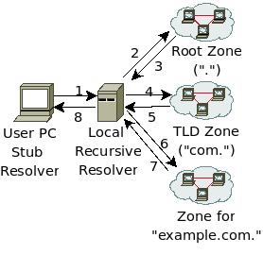
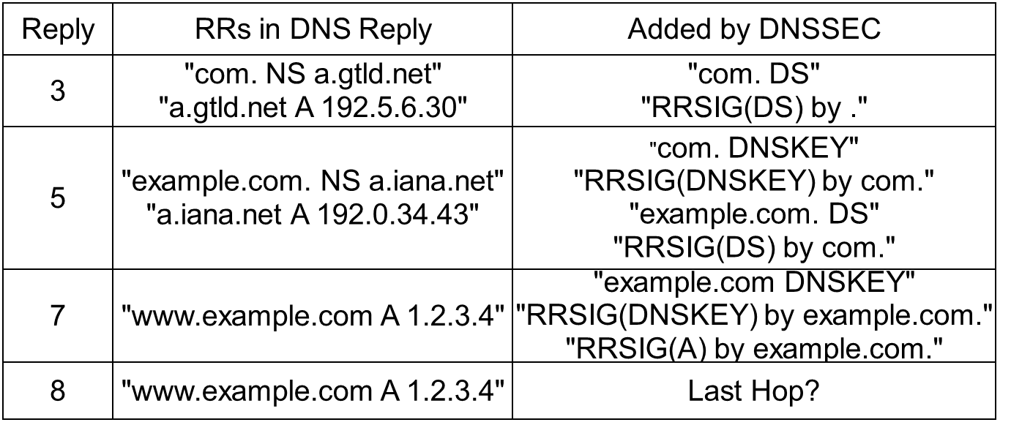
DNSSEC – Lookup
Query: "www.example.com A?"

Slide 43
DNSSEC Issues
Benefits:
DNSSEC allows to effectively counter unauthorized/spoofed DNS records
Drawbacks:
Added complexity (signing, checking, key distribution)
Significant chance of misconfiguration
Eases DoS attacks on DNS servers
Zones need to be completely signed (performance challenge for large companies or registries)
Distribution of anchor keys still a manual task (allows for human error, social engineering)

Slide 44
Summary
What is DNS? How does it work?
What are the vulnerabilities with DNS?
What are the threats to DNS?
What is DNSSEC? What are the benefits and drawbacks of DNSSEC?

Slide 45
Class Survey
Please complete the CSC3064 survey:
https://goo.gl/forms/RPypsbngPzoxIy4Y2

Slide 46
Student Handbook - Survey
Please answer the short survey at the following link to help us improve the Student Handbook:
https://www.surveymonkey.co.uk/r/THMVMDS
Thank you!

Slide 47
Questions?
Next Session: Tuesday, 12 February 2019
NAT, Tunneling and VPN

